Slide 1
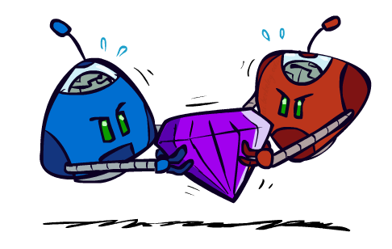
AI: Representation and Problem Solving
Game Theory
Instructors: Pat Virtue & Stephanie Rosenthal
Slide credits: Ariel Procaccia, Fei Fang

Slide 2
Announcements
Written homework due 4/25
Electronic assignment due next week
Programming assignment due 5/2
Final exam 5/9 1-4pm (Rashid Auditorium)
You’re doing great!!!

Slide 3
Autonomous Agents 15-482
Agent Architectures
Task scheduling
Reasoning under uncertainty
Error monitoring
Explanation
Robotanist Project – automated greenhouses

Slide 4
Nils Nilsson (1933-2019)
Stanford Research Institute and Stanford University
Inventor of A*
Inventor of automated temporal planning
Inventor of STRIPS classical planning framework
Research interests in search, planning, knowledge representation, robotics, and more…

Slide 5
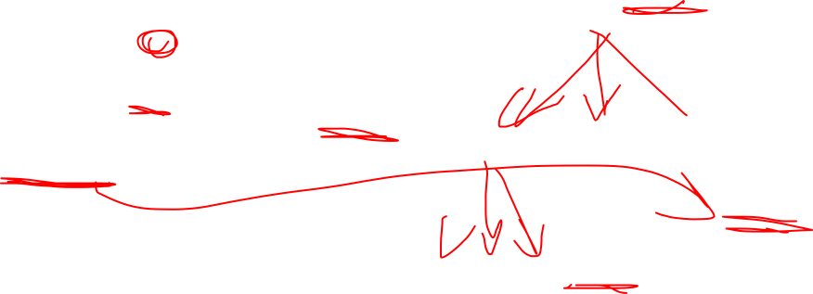
Representing Actions in the World
MARKOV DECISION PROCESSES
GAME TREE
STATES
s
a
REWARDS
UTILITIES
COSTS
ACTIONS
a
a
PROBABILISTIC
WORLD
OUTCOMES
PROBABILISTIC
WORLD
OUTCOMES
UTILITIES

Slide 6
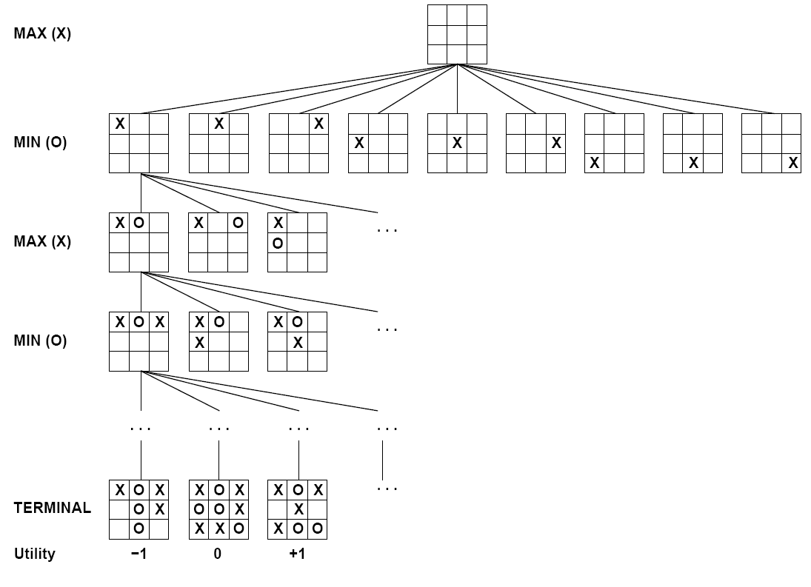
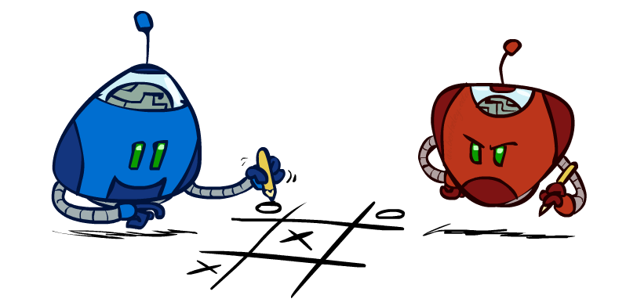
Tic Tac Toe
GAME TREE
STATES
ACTIONS
OPPONENT
ACTIONS
UTILITIES

Slide 7
Navigating in GHC
MARKOV DECISION PROCESSES
LOCATIONS
MOVE
s
a
TURN
REWARDS
UTILITIES
COSTS
STOP
a
a
WHEEL SLIP
HIT BUMP
STUCK

Slide 8
Wheel Of Fortune
MARKOV DECISION PROCESSES
PUZZLE
SPIN
s
a
BUY
$$$
SOLVE
a
a
WHEEL
OUTCOME

Slide 9

Wheel Of Fortune
MARKOV DECISION PROCESSES
GAME TREE
PUZZLE
PUZZLE
SPIN
s
a
BUY
$$$
ACTIONS
SOLVE
a
a
WHEEL
OUTCOME
WHEEL
OUTCOMES
$$$

Slide 10
15-381 Exam
MARKOV DECISION PROCESSES
GAME TREE
YOUR KNOWLEDGE
YOUR KNOWLEDGE
STUDY
s
a
HW
SCORE
ACTIONS
GAMES
a
a
TEST
DIFFICULTY
TEST
DIFFICULTY
SCORE

Slide 11
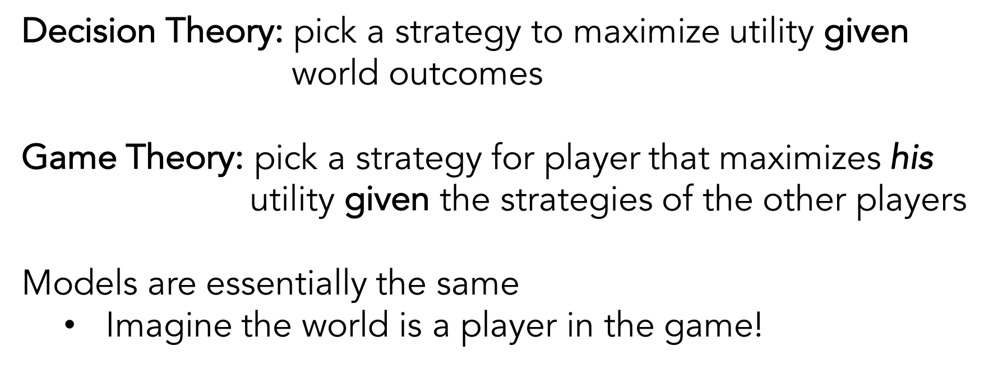
Decision Theory and Game Theory
Decision Theory: pick a strategy to maximize utility given world outcomes
Game Theory: pick a strategy for player that maximizes his utility given the strategies of the other players
Models are essentially the same
Imagine the world is a player in the game!

Slide 12
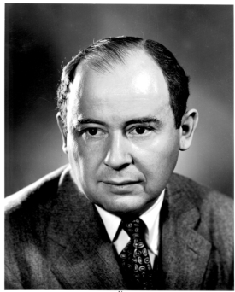

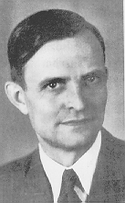
History of Game Theory
Game theory is the study of strategic decision making (of more than one player)
Used in economics, political science etc.
John von Neumann John Nash Heinrich Freiherr von Stackelberg
Winners of Nobel Memorial Prize in Economic Sciences
Notes:
Game theory is the study of strategic decision making.
More specifically, game theory is the study of mathematical models of conflict and cooperation between intelligent decision-makers. The games studied in game theory must have elements including the players, information, actions and payoffs.
Although the first known discussion of game theory is for a two-player card game, game theory is not only designed for entertaining games. Modern game theory has been used in economics and political science. Nobel Prize winners John von Neumann, John Nash, Heinrich Freiherr von Stackelberg

Slide 13
Games: Extensive Form
Represent:
1) the players of a game
2) for every player, every opportunity they have to move
3) what each player can do at each of their moves
4) what each player knows when making every move
5) the payoffs received by everyone for all possible combo of moves

Slide 14

Decisions: Extensive Form
Represent:
the player(s) of a game
2) every opportunity they have to act
3) what the player can do at each of their turns
4) the uncertain outcomes of actions
5) what each player knows/observes for every turn
6) the payoffs received for all possible combo of actions
YOUR KNOWLEDGE
ACTIONS
TEST
DIFFICULTY
SCORE

Slide 15
Alternative: Normal Form
Approximate games as single shot
Represent only actions and utilities
Easier to determine particular properties of games

Slide 16
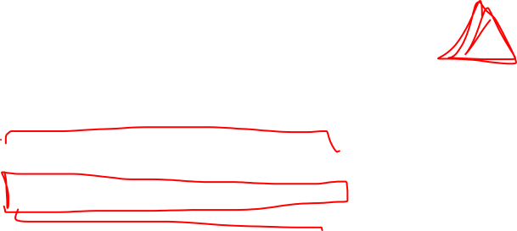
Studying – Normal Form Game
Approximate games as single shot
Represent only actions and utilities
GAME TREE
YOUR KNOWLEDGE
ACTIONS
ACTIONS
CRAM | DO HW | PLAY GAME
98 | 100 | 85
GRADE
TEST
DIFFICULTY
UTILITIES

Slide 17

Studying – Normal Form Game
Approximate games as single shot
Represent only actions and utilities
GAME TREE
YOUR KNOWLEDGE
ACTIONS
ACTIONS
CRAM | DO HW | PLAY GAME
98 | 100 | 85
97 | 90 | 65
EASY
TEST
DIFFICULTY
HARD
UTILITIES

Slide 18
Studying - Actions and Utilities
World outcomes
ACTIONS
CRAM | DO HW | PLAY GAME
98 | 100 | 85
97 | 90 | 65
EASY
HARD
UTILITIES

Slide 19
Studying - Actions and Utilities
The world acts at the same time as you choose an action
ACTIONS
CRAM | DO HW | PLAY GAME
98 | 100 | 85
97 | 90 | 65
EASY
HARD
UTILITIES

Slide 20
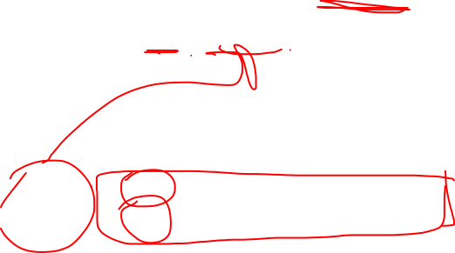
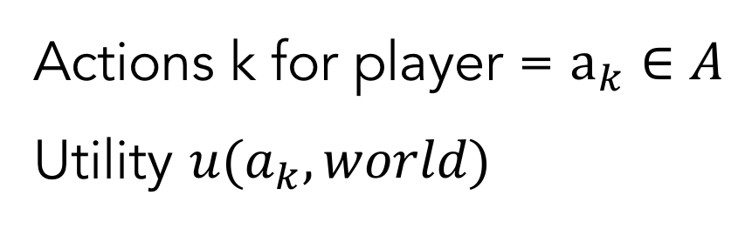
Action/Utility Notation
Actions k for player = $a_{k}∈A$
Utility ${u(a}_{k},world)$
ACTIONS
CRAM | DO HW | PLAY GAME
98 | 100 | 85
97 | 90 | 65
EASY
HARD
UTILITIES

Slide 21
Questions you can ask…
What action should you take?
ACTIONS
CRAM | DO HW | PLAY GAME
98 | 100 | 85
97 | 90 | 65
EASY
HARD
UTILITIES

Slide 22
Questions you can ask…
What action should you take?
- Maximize the expected utility based on world probabilities
ACTIONS
CRAM | DO HW | PLAY GAME
98 | 100 | 85
97 | 90 | 65
EASY
HARD
UTILITIES

Slide 23
Questions you can ask…
What strategy (probability distribution over actions) should you use?
ACTIONS
CRAM | DO HW | PLAY GAME
98 | 100 | 85
97 | 90 | 65
EASY
HARD
UTILITIES

Slide 24
Strategies
Strategy for player $=s_{k}∈S$: probability distribution over actions
ACTIONS
Strategy 1: Always cram
Strategy 2: Always do HW
Strategy 3: Always play games
Strategy 4: ½ cram, ½ do HW
…
CRAM | DO HW | PLAY GAME
98 | 100 | 85
97 | 90 | 65
EASY
HARD
UTILITIES

Slide 25

Pure vs Mixed Strategies
Strategy for player $=s_{k}∈S$: probability distribution over actions
Pure Strategy: deterministic (p=1) selection of actions
Strategy 1: Always cram
Strategy 2: Always do HW
Strategy 3: Always play games
Strategy 4: ½ cram, ½ do HW
…
CRAM | DO HW | PLAY GAME
98 | 100 | 85
97 | 90 | 65
Mixed Strategy: randomized selection

Slide 26
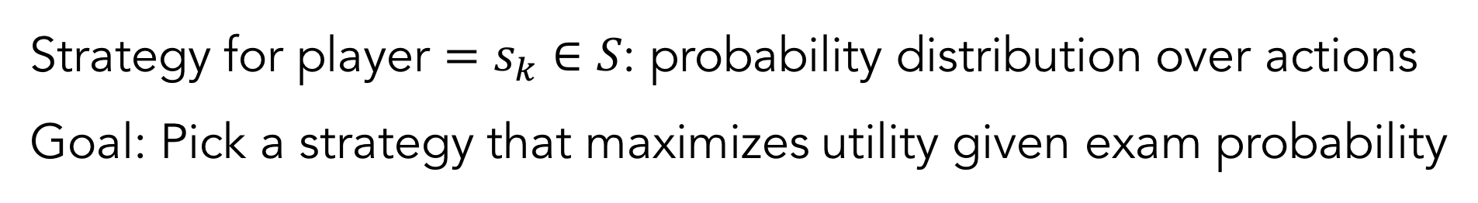
Strategies
Strategy for player $=s_{k}∈S$: probability distribution over actions
Goal: Pick a strategy that maximizes utility given exam probability
Strategy 1: Always cram
Strategy 2: Always do HW
Strategy 3: Always play games
Strategy 4: ½ cram, ½ do HW
…
CRAM | DO HW | PLAY GAME
98 | 100 | 85
97 | 90 | 65

Slide 27
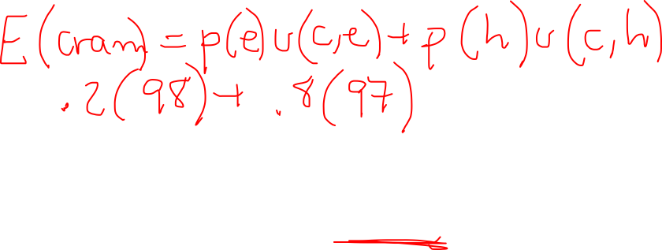
Calculating Utilities of Pure Strategies
What is the utility of pure strategy: cram?
CRAM | DO HW | PLAY GAME
98 | 100 | 85
97 | 90 | 65
P(EASY) = .2
P(HARD) = .8

Slide 28
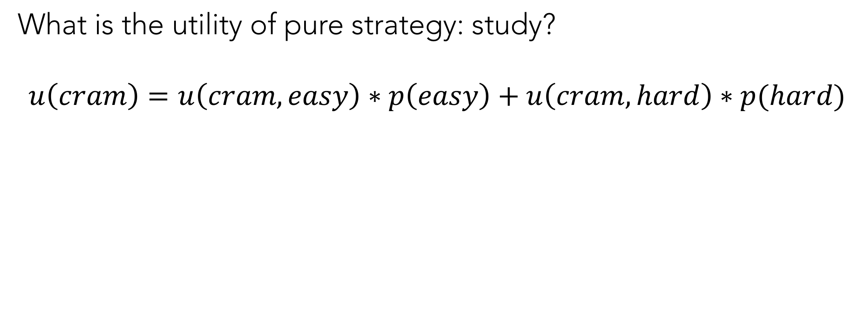
Calculating Utilities of Pure Strategies
What is the utility of pure strategy: study?
$$u\left(cram\right)=u\left(cram,easy\right)∗p\left(easy\right)+u\left(cram,hard\right)∗p(hard)$$
CRAM | DO HW | PLAY GAME
98 | 100 | 85
97 | 90 | 65
P(EASY) = .2
P(HARD) = .8

Slide 29
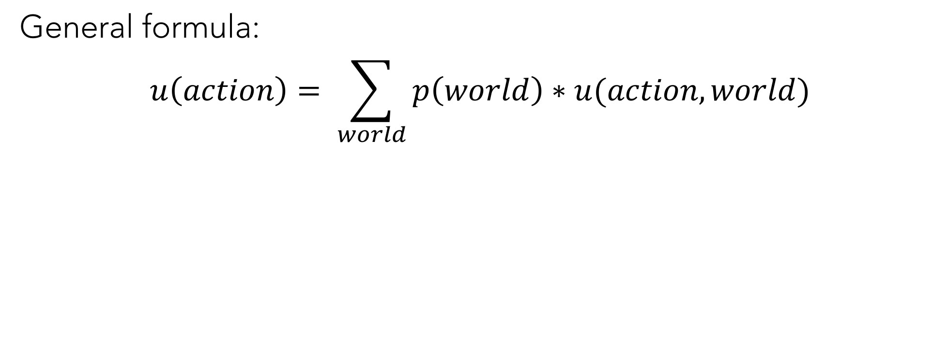
Calculating Utilities of Pure Strategies
General formula:
$$u\left(action\right)= \sum_{world}{p\left(world\right)∗u(action,world)}$$
CRAM | DO HW | PLAY GAME
98 | 100 | 85
97 | 90 | 65
P(EASY) = .2
P(HARD) = .8

Slide 30
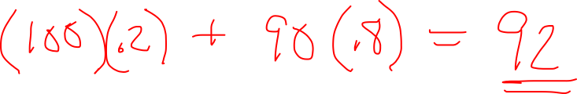
Calculating Utilities of Pure Strategies
What is the utility of pure strategy: do hw?
CRAM | DO HW | PLAY GAME
98 | 100 | 85
97 | 90 | 65
P(EASY) = .2
P(HARD) = .8

Slide 31
Calculating Utilities of Pure Strategies
What is the utility of pure strategy: play game?
CRAM | DO HW | PLAY GAME
98 | 100 | 85
97 | 90 | 65
P(EASY) = .2
P(HARD) = .8

Slide 32
Calculating Utilities of Mixed Strategies
What is the utility of mixed strategy: ½ cram, ½ do hw?
CRAM | DO HW | PLAY GAME
98 | 100 | 85
97 | 90 | 65
P(EASY) = .2
P(HARD) = .8

Slide 33

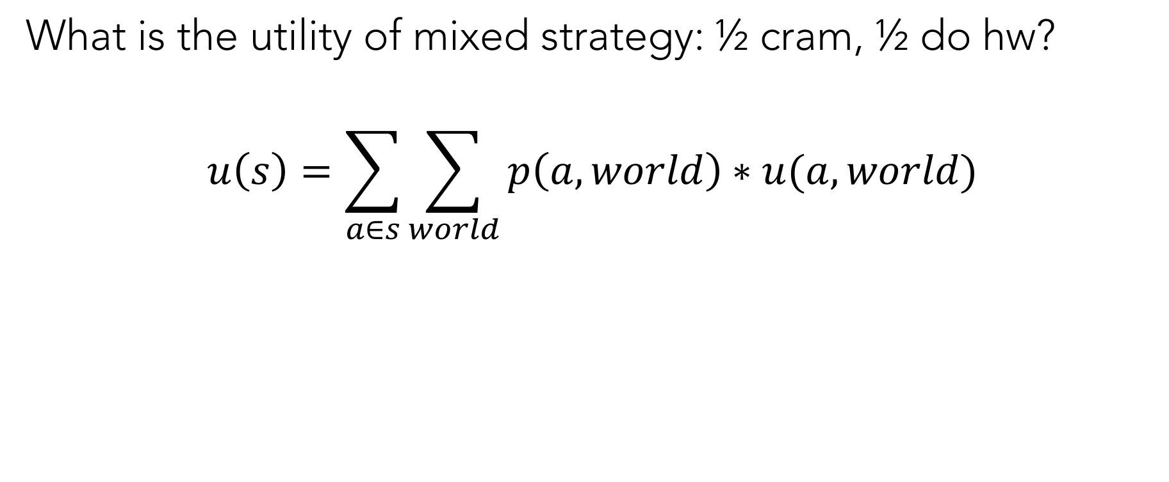
Calculating Utilities of Mixed Strategies
What is the utility of mixed strategy: ½ cram, ½ do hw?
$$u\left(s\right)=\sum_{a∈s}{\sum_{world}{p\left(a,world\right)∗u(a,world)}}$$
CRAM | DO HW | PLAY GAME
98 | 100 | 85
97 | 90 | 65
P(EASY) = .2
P(HARD) = .8

Slide 34
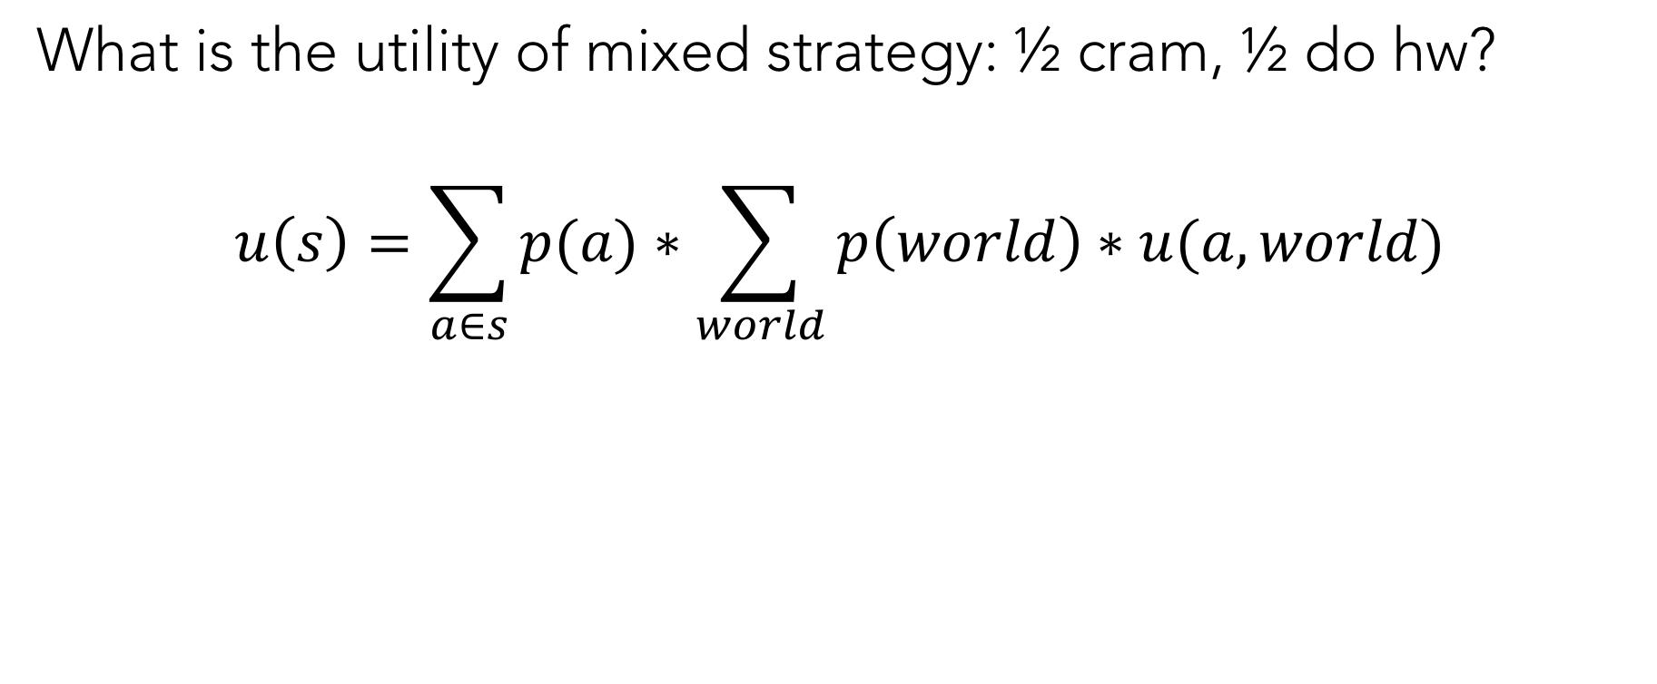
Calculating Utilities of Mixed Strategies
What is the utility of mixed strategy: ½ cram, ½ do hw?
$$u\left(s\right)=\sum_{a∈s}{p(a)}∗\sum_{world}{p\left(world\right)∗u(a,world)}$$
CRAM | DO HW | PLAY GAME
98 | 100 | 85
97 | 90 | 65
P(EASY) = .2
P(HARD) = .8

Slide 35
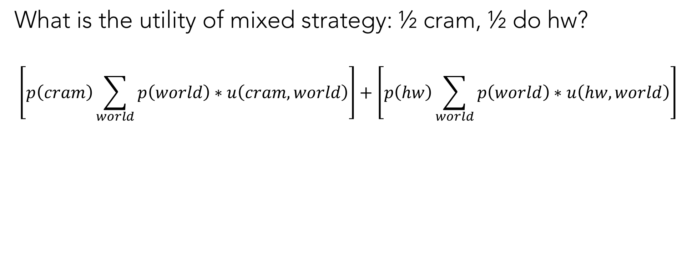
Calculating Utilities of Mixed Strategies
What is the utility of mixed strategy: ½ cram, ½ do hw?
$$\left[p\left(cram\right)\sum_{world}{p\left(world\right)∗u\left(cram,world\right)}\right]+\left[p\left(hw\right)\sum_{world}{p\left(world\right)∗u\left(hw,world\right)}\right]$$
CRAM | DO HW | PLAY GAME
98 | 100 | 85
97 | 90 | 65
P(EASY) = .2
P(HARD) = .8

Slide 36
Grocery Shopping Transportation Decision
Suppose you want to decide how to get groceries from the store
BIKE | WALK | BUS | DRIVE
1 | 2 | 1 | 1
-2 | -4 | -1 | 0
SUN
RAIN

Slide 37
Polls 1 and 2
Suppose you want to decide how to get groceries from the store
BIKE | WALK | BUS | DRIVE
1 | 2 | 1 | 1
-2 | -4 | -1 | 0
SUN
RAIN
How many pure strategies to do you have?
A) 1 B) 2 C) 3 D) 4 E) Infinite
How many mixed strategies do you have?
A) 4 B) 8 C) 16 D) 64 E) Infinite

Slide 38
Poll 3
Suppose you want to decide how to get groceries from the store
BIKE | WALK | BUS | DRIVE
1 | 2 | 1 | 1
-2 | -4 | -1 | 0
SUN
RAIN
What is your best pure strategy?
A) bike B) walk C) bus D) drive E) it depends

Slide 39
Poll 4
Suppose you want to decide how to get groceries from the store
BIKE | WALK | BUS | DRIVE
1 | 2 | 1 | 1
-2 | -4 | -1 | 0
SUN
P=.5
RAIN
P=.5
What is your best pure strategy?
A) bike B) walk C) bus D) drive E) it depends

Slide 40
Poll 5
Suppose you want to decide how to get groceries from the store
BIKE | WALK | BUS | DRIVE
1 | 2 | 1 | 1
-2 | -4 | -1 | 0
SUN
P=.5
RAIN
P=.5
What is the utility of a ¼ walk, ¼ bike, and ½ drive strategy?
A) -1/8 B) -1/4 C) -1/2 D) 1/8 E) 1/2

Slide 41
Game Theory

Slide 42
Game: Rock, Paper, Scissors
Each player simultaneously picks rock, paper, or scissors
Rock beats scissors, scissors beats paper, paper beats rock

Slide 43
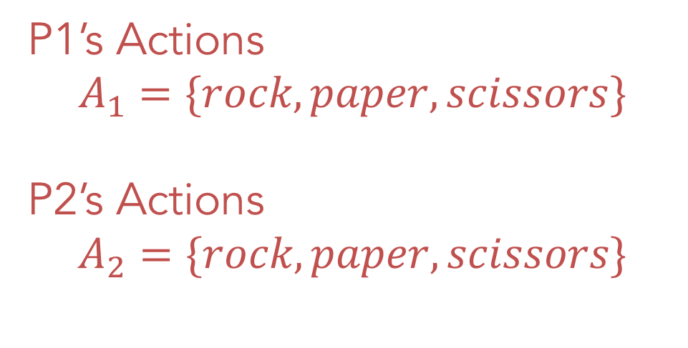
Game: Rock, Paper, Scissors
Each player simultaneously picks rock, paper, or scissors
Rock beats scissors, scissors beats paper, paper beats rock
P1’s Actions
$$A_{1}=\{rock, paper, scissors\}$$
P2’s Actions
$$A_{2}=\{rock, paper, scissors\}$$

Slide 44
Joint Utilities
When both players choose their actions, they receive a utility based on both of their choices
P2’s ACTIONS
 |  | PLAYER 2
 |  | ROCK | PAPER | SCISSORS
PLAYER 1 | ROCK
 | PAPER
 | SCISSORS
JOINT UTILITIES

Slide 45

Joint Utilities
When both players choose their actions, they receive a utility based on both of their choices
P2’s ACTIONS
 |  | PLAYER 2
 |  | ROCK | PAPER | SCISSORS
PLAYER 1 | ROCK | 0,0 | -1,1 | 1,-1
 | PAPER | 1,-1 | 0,0 | -1,1
 | SCISSORS | -1,1 | 1,-1 | 0,0
JOINT UTILITIES

Slide 46

Poll 5
What is P1’s utility of P1 picking rock and P2 picking scissors?
P2’s ACTIONS
 |  | PLAYER 2
 |  | ROCK | PAPER | SCISSORS
PLAYER 1 | ROCK | 0,0 | -1,1 | 1,-1
 | PAPER | 1,-1 | 0,0 | -1,1
 | SCISSORS | -1,1 | 1,-1 | 0,0
JOINT UTILITIES

Slide 47
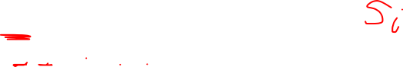
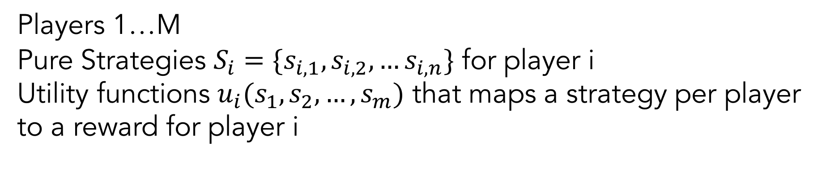
Normal Form Notation
Players 1…M
Pure Strategies $S_{i}=\{s_{i,1},s_{i,2}, …s_{i,n}\}$ for player i
Utility functions $u_{i}(s_{1},s_{2},…,s_{m})$ that maps a strategy per player to a reward for player i
 |  | PLAYER 2
 |  | ROCK | PAPER | SCISSORS
PLAYER 1 | ROCK | 0,0 | -1,1 | 1,-1
 | PAPER | 1,-1 | 0,0 | -1,1
 | SCISSORS | -1,1 | 1,-1 | 0,0

Slide 48
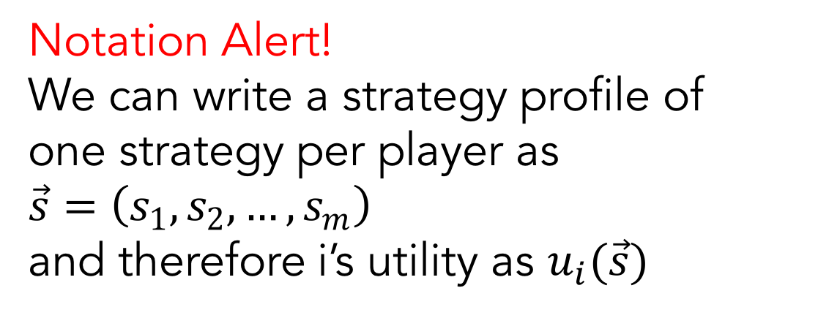

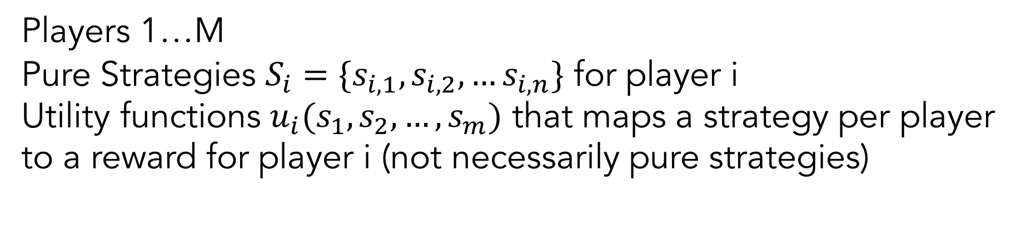
Normal Form Notation
Players 1…M
Pure Strategies $S_{i}=\{s_{i,1},s_{i,2}, …s_{i,n}\}$ for player i
Utility functions $u_{i}(s_{1},s_{2},…,s_{m})$ that maps a strategy per player to a reward for player i (not necessarily pure strategies)
Notation Alert!
We can write a strategy profile of one strategy per player as $\vec{s}=\left(s_{1},s_{2},…,s_{m}\right)$
and therefore i’s utility as $u_{i}(\vec{s})$
 |  | PLAYER 2
 |  | ROCK | PAPER | SCISSORS
PLAYER 1 | ROCK | 0,0 | -1,1 | 1,-1
 | PAPER | 1,-1 | 0,0 | -1,1
 | SCISSORS | -1,1 | 1,-1 | 0,0

Slide 49
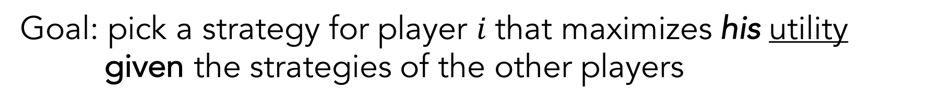
Strategies for Games
Goal: pick a strategy for player $i$that maximizes his utility given the strategies of the other players
Pure Strategies:
P2 always picks rock
P1 should ____________
P2 always picks paper
P1 should ____________
 |  | PLAYER 2
 |  | ROCK | PAPER | SCISSORS
PLAYER 1 | ROCK | 0,0 | -1,1 | 1,-1
 | PAPER | 1,-1 | 0,0 | -1,1
 | SCISSORS | -1,1 | 1,-1 | 0,0

Slide 50
Strategies for Games
Goal: pick a strategy for player $i$that maximizes his utility given the strategies of the other players
Mixed Strategies:
P2 randomly chooses between 50% rock and 50% paper
P1 should ____________
 |  | PLAYER 2
 |  | ROCK | PAPER | SCISSORS
PLAYER 1 | ROCK | 0,0 | -1,1 | 1,-1
 | PAPER | 1,-1 | 0,0 | -1,1
 | SCISSORS | -1,1 | 1,-1 | 0,0

Slide 51

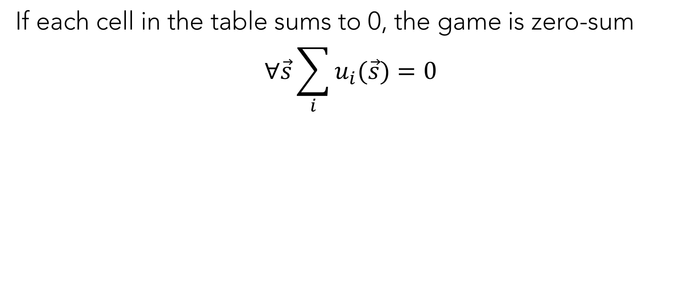
Zero-Sum Games
If each cell in the table sums to 0, the game is zero-sum
$$∀\vec{s}\sum_{i}{u_{i}(\vec{s})}=0$$
 |  | PLAYER 2
 |  | ROCK | PAPER | SCISSORS
PLAYER 1 | ROCK | 0,0 | -1,1 | 1,-1
 | PAPER | 1,-1 | 0,0 | -1,1
 | SCISSORS | -1,1 | 1,-1 | 0,0

Slide 52
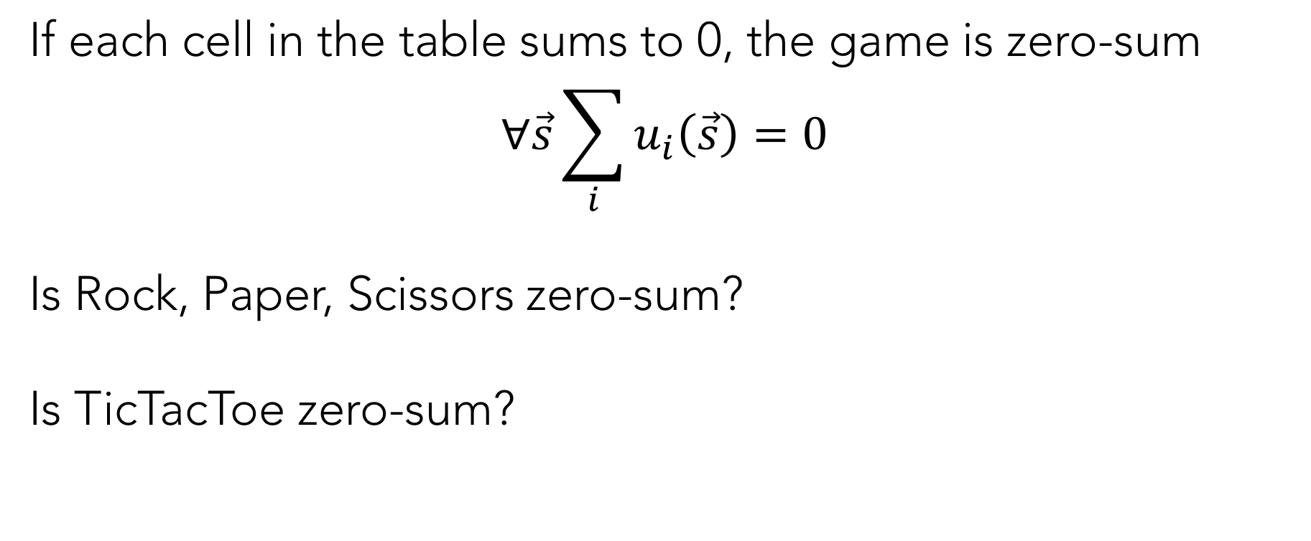
Zero-Sum Games
If each cell in the table sums to 0, the game is zero-sum
$$∀\vec{s}\sum_{i}{u_{i}\left(\vec{s}\right)}=0$$
Is Rock, Paper, Scissors zero-sum?
Is TicTacToe zero-sum?
 |  | PLAYER 2
 |  | ROCK | PAPER | SCISSORS
PLAYER 1 | ROCK | 0,0 | -1,1 | 1,-1
 | PAPER | 1,-1 | 0,0 | -1,1
 | SCISSORS | -1,1 | 1,-1 | 0,0

Slide 53
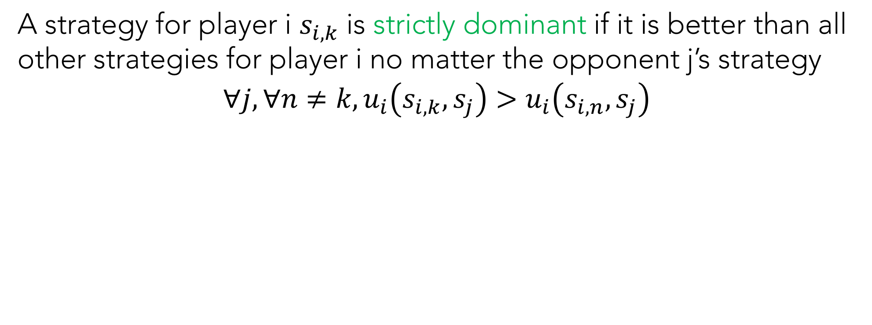

Dominant Strategies
A strategy for player i $s_{i,k}$ is strictly dominant if it is better than all other strategies for player i no matter the opponent j’s strategy
$$∀j,∀n≠k, u_{i}\left(s_{i,k},s_{j}\right)>u_{i}\left(s_{i,n},s_{j}\right)$$
 | A | B | C | D | E
i | 2,10 | 4,7 | 4,6 | 5,2 | 3,8
ii | 3,8 | 6,4 | 5,2 | 1,3 | 2,6
iii | 5,3 | 3,1 | 2,2 | 4,1 | 3,0
iv | 6,7 | 9,5 | 7,5 | 8,5 | 5,5

Slide 54


Dominant Strategies
A strategy for player i $s_{i,k}$ is weakly dominant if it is better than all other strategies for player i no matter the opponent j’s strategy
$$∀j,∀n≠k, u_{i}\left(s_{i,k},s_{j}\right)≥u_{i}\left(s_{i,n},s_{j}\right)$$
 | A | B | C | D | E
i | 2,10 | 4,7 | 4,6 | 5,2 | 3,8
ii | 3,8 | 6,4 | 5,2 | 1,3 | 2,6
iii | 5,3 | 3,1 | 2,2 | 4,1 | 3,0
iv | 6,7 | 9,5 | 7,5 | 8,5 | 5,5

Slide 55

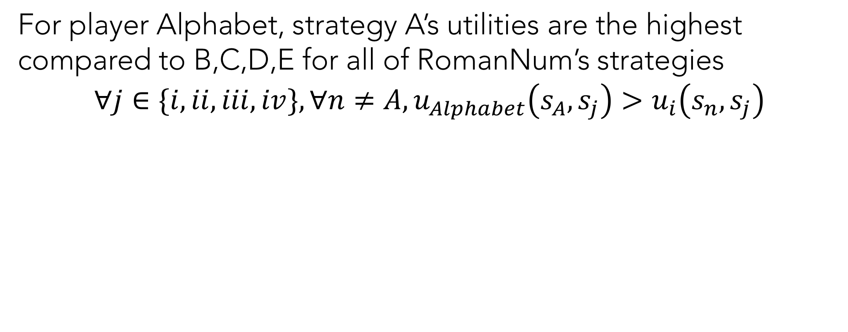
Dominant Strategies
For player Alphabet, strategy A’s utilities are the highest compared to B,C,D,E for all of RomanNum’s strategies
$$∀j∈\{i,ii,iii,iv\},∀n≠A, u_{Alphabet}\left(s_{A},s_{j}\right)>u_{i}\left(s_{n},s_{j}\right)$$
 | A | B | C | D | E
i | 2,10 | 4,7 | 4,6 | 5,2 | 3,8
ii | 3,8 | 6,4 | 5,2 | 1,3 | 2,6
iii | 5,3 | 3,1 | 2,2 | 4,1 | 3,0
iv | 6,7 | 9,5 | 7,5 | 8,5 | 5,5

Slide 56
Dominant Strategies
For player Alphabet, strategy A’s utilities are the highest compared to B,C,D,E for all of RomanNum’s strategies
Alphabet should always play A!
 | A | B | C | D | E
i | 2,10 | 4,7 | 4,6 | 5,2 | 3,8
ii | 3,8 | 6,4 | 5,2 | 1,3 | 2,6
iii | 5,3 | 3,1 | 2,2 | 4,1 | 3,0
iv | 6,7 | 9,5 | 7,5 | 8,5 | 5,5

Slide 57

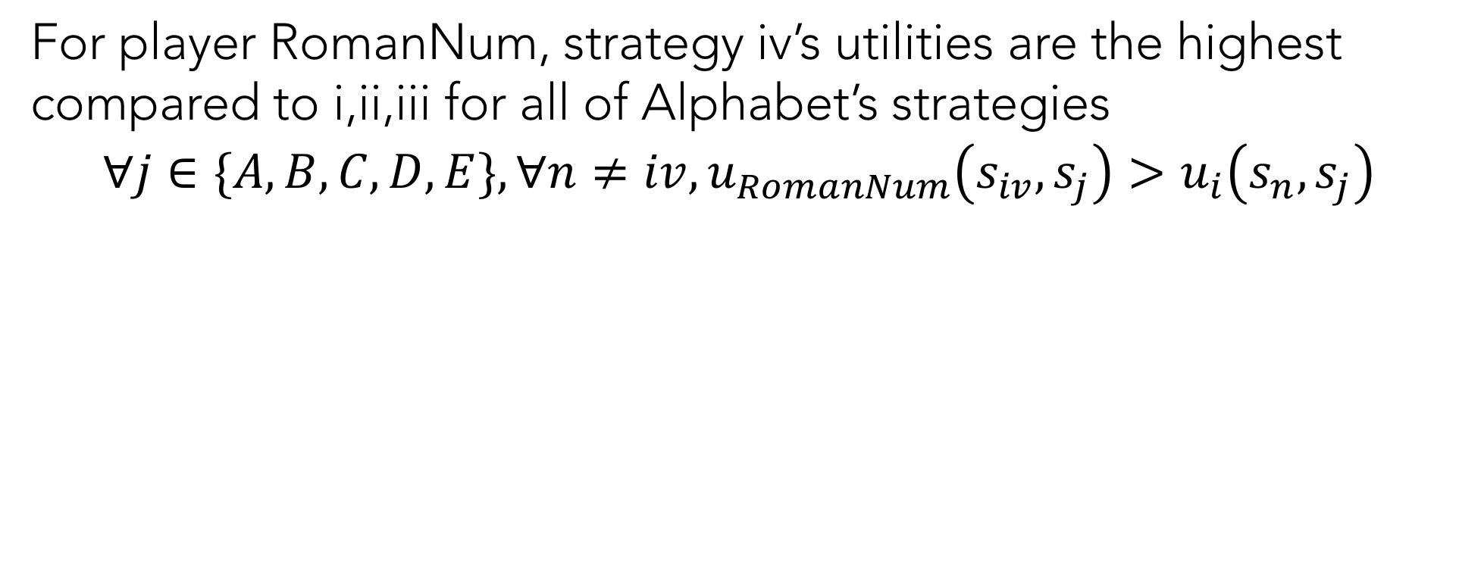
Dominant Strategies
For player RomanNum, strategy iv’s utilities are the highest compared to i,ii,iii for all of Alphabet’s strategies
$$∀j∈\{A,B,C,D,E\},∀n≠iv, u_{RomanNum}\left(s_{iv},s_{j}\right)>u_{i}\left(s_{n},s_{j}\right)$$
 | A | B | C | D | E
i | 2,10 | 4,7 | 4,6 | 5,2 | 3,8
ii | 3,8 | 6,4 | 5,2 | 1,3 | 2,6
iii | 5,3 | 3,1 | 2,2 | 4,1 | 3,0
iv | 6,7 | 9,5 | 7,5 | 8,5 | 5,5

Slide 58
Dominant Strategies
For player RomanNum, strategy iv’s utilities are the highest compared to i,ii,iii for all of Alphabet’s strategies
RomanNum should always play iv!
 | A | B | C | D | E
i | 2,10 | 4,7 | 4,6 | 5,2 | 3,8
ii | 3,8 | 6,4 | 5,2 | 1,3 | 2,6
iii | 5,3 | 3,1 | 2,2 | 4,1 | 3,0
iv | 6,7 | 9,5 | 7,5 | 8,5 | 5,5

Slide 59
Poll 6: Is there always a dominant strategy?
Yes or No?

Slide 60
Is there always a dominant strategy?
No! There is no dominant strategy in Tic Tac Toe, for example.
 |  | PLAYER 2
 |  | ROCK | PAPER | SCISSORS
PLAYER 1 | ROCK | 0,0 | -1,1 | 1,-1
 | PAPER | 1,-1 | 0,0 | -1,1
 | SCISSORS | -1,1 | 1,-1 | 0,0

Slide 61
Prisoner’s Dilemma
 |  | PRISONER 2
 |  | Cooperate | Defect
PRISONER 1 | Cooperate | -1,-1 | -6,0
 | Defect | 0,-6 | -3,-3

Slide 62
Prisoner’s Dilemma: Normal Form
2 Players {1,2}
Each as 2 actions {Cooperate,Defect}
Utilities in table:
 |  | PRISONER 2
 |  | Cooperate | Defect
PRISONER 1 | Cooperate | -1,-1 | -6,0
 | Defect | 0,-6 | -3,-3

Slide 63
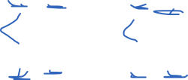
Prisoner’s Dilemma Poll
Is there a dominant strategy?
 |  | PRISONER 2
 |  | Cooperate | Defect
PRISONER 1 | Cooperate | -1,-1 | -6,0
 | Defect | 0,-6 | -3,-3

Slide 64
Prisoner’s Dilemma
Is there a dominant strategy? Yes!
 |  | PRISONER 2
 |  | Cooperate | Defect
PRISONER 1 | Cooperate | -1,-1 | -6,0
 | Defect | 0,-6 | -3,-3

Slide 65
Prisoner’s Dilemma
Is there a dominant strategy? Yes!
 |  | PRISONER 2
 |  | Cooperate | Defect
PRISONER 1 | Cooperate | -1,-1 | -6,0
 | Defect | 0,-6 | -3,-3

Slide 66
Prisoner’s Dilemma
Is there a dominant strategy? Yes!
 |  | PRISONER 2
 |  | Cooperate | Defect
PRISONER 1 | Cooperate | -1,-1 | -6,0
 | Defect | 0,-6 | -3,-3

Slide 67

Prisoner’s Dilemma
What is the best joint strategy for both prisoners?
 |  | PRISONER 2
 |  | Cooperate | Defect
PRISONER 1 | Cooperate | -1,-1 | -6,0
 | Defect | 0,-6 | -3,-3

Slide 68
Prisoner’s Dilemma
Best joint strategy: prisoners cooperate
 |  | PRISONER 2
 |  | Cooperate | Defect
PRISONER 1 | Cooperate | -1,-1 | -6,0
 | Defect | 0,-6 | -3,-3

Slide 69
Measure of Social Welfare
The sum of the utilities of the players is the social welfare
SW(C,C) = -2
SW(C,D) = -6
SW(D,D) = -6
 |  | PRISONER 2
 |  | Cooperate | Defect
PRISONER 1 | Cooperate | -1,-1 | -6,0
 | Defect | 0,-6 | -3,-3
Notes:
optimal social welfare for all pure strategy games here is -2.

Slide 70
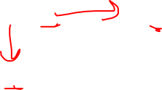
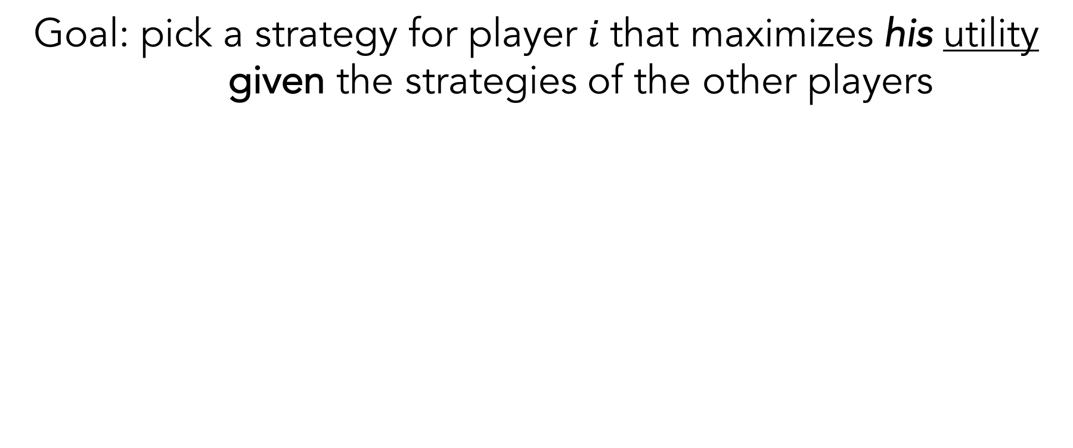
Prisoner’s Dilemma
Goal: pick a strategy for player $i$that maximizes his utility given the strategies of the other players
 |  | PRISONER 2
 |  | Cooperate | Defect
PRISONER 1 | Cooperate | -1,-1 | -6,0
 | Defect | 0,-6 | -3,-3

Slide 71
Prisoner’s Dilemma
Each prisoner would profit by switching to defection assuming that the other prisoner continues to cooperate
 |  | PRISONER 2
 |  | Cooperate | Defect
PRISONER 1 | Cooperate | -1,-1 | -6,0
 | Defect | 0,-6 | -3,-3

Slide 72
Prisoner’s Dilemma
Each prisoner would profit by switching to defection assuming that the other prisoner continues to cooperate
 |  | PRISONER 2
 |  | Cooperate | Defect
PRISONER 1 | Cooperate | -1,-1 | -6,0
 | Defect | 0,-6 | -3,-3

Slide 73
Prisoner’s Dilemma
If they both trust that the other prisoner will cooperate, each should defect. But both defecting results in lower scores!
 |  | PRISONER 2
 |  | Cooperate | Defect
PRISONER 1 | Cooperate | -1,-1 | -6,0
 | Defect | 0,-6 | -3,-3

Slide 74
Tragedy of the Commons
Individuals act in their own self-interest contrary to the common good
Political Ads
Nuclear Arms Race
CO2 Emissions

Slide 75

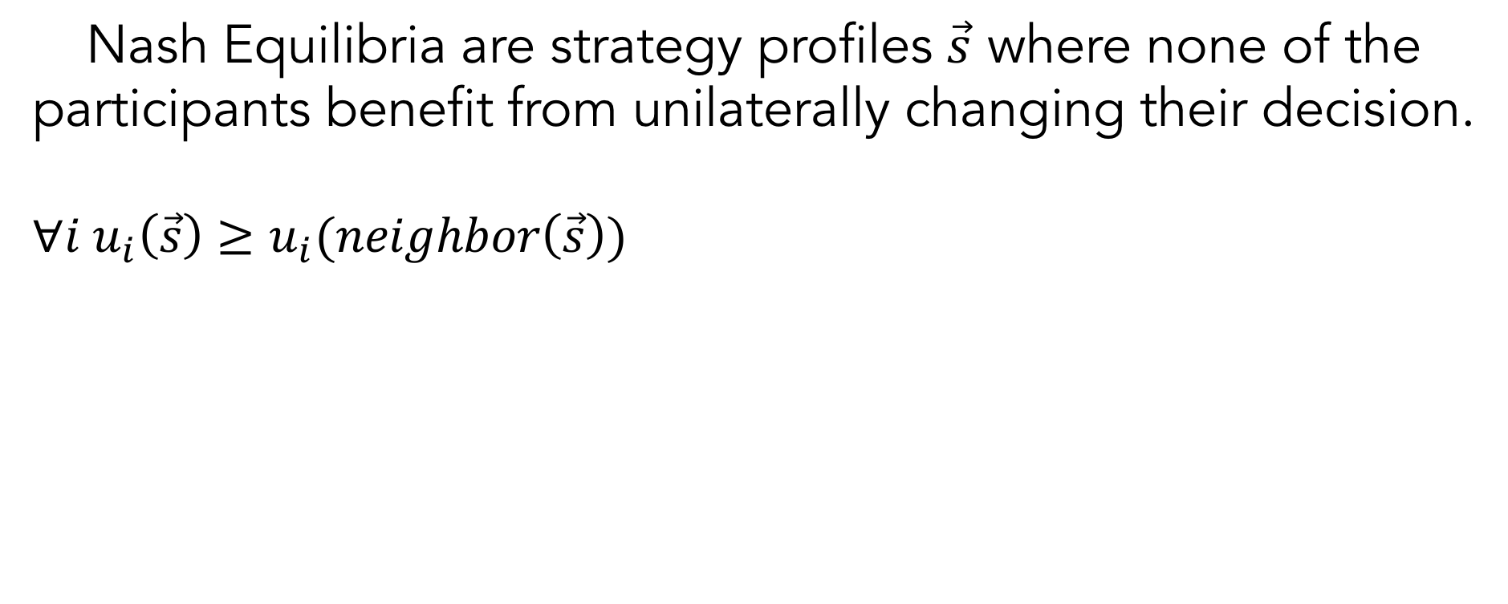
Nash Equilibrium
Nash Equilibria are strategy profiles $\vec{s}$ where none of the participants benefit from unilaterally changing their decision.
$$∀i u_{i}\left(\vec{s}\right)≥u_{i}(neighbor\left(\vec{s}\right))$$
 |  | PRISONER 2
 |  | Cooperate | Defect
PRISONER 1 | Cooperate | -1,-1 | -6,0
 | Defect | 0,-6 | -3,-3

Slide 76
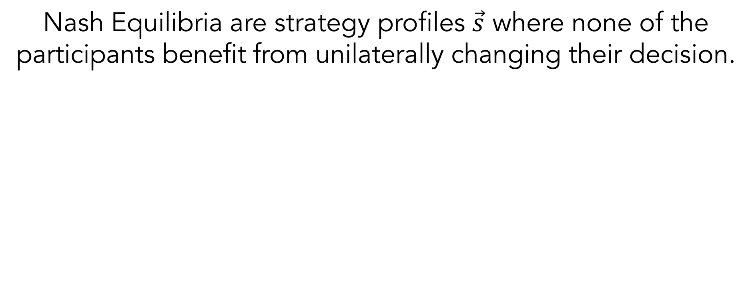
Nash Equilibrium
Nash Equilibria are strategy profiles $\vec{s}$ where none of the participants benefit from unilaterally changing their decision.
 |  | PRISONER 2
 |  | Cooperate | Defect
PRISONER 1 | Cooperate | -1,-1 | -6,0
 | Defect | 0,-6 | -3,-3

Slide 77

Nash Equilibrium
NOT A NASH EQUILIBRIUM - participants benefit from unilaterally changing their decision.
 |  | PRISONER 2
 |  | Cooperate | Defect
PRISONER 1 | Cooperate | -1,-1 | -6,0
 | Defect | 0,-6 | -3,-3

Slide 78

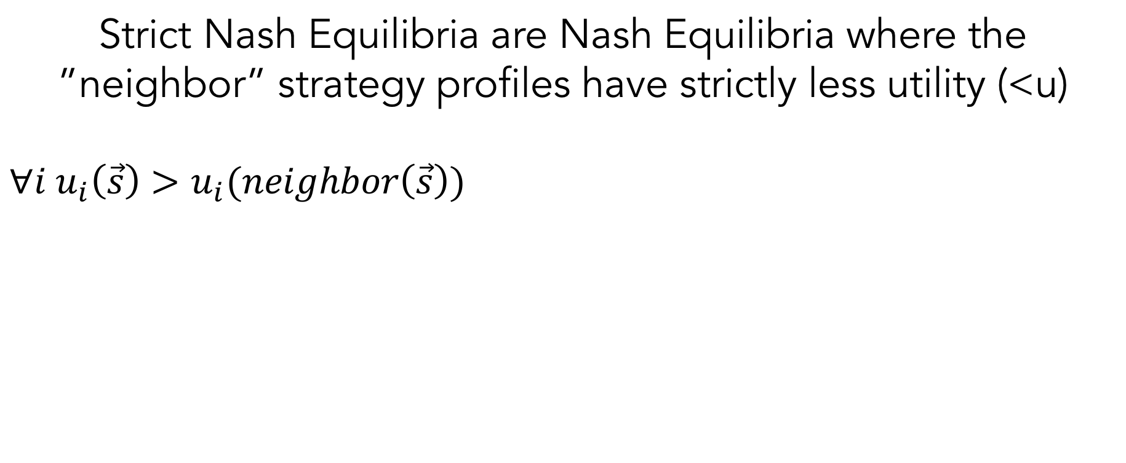
Strict Nash Equilibrium
Strict Nash Equilibria are Nash Equilibria where the ”neighbor” strategy profiles have strictly less utility (<u)
$$∀i u_{i}\left(\vec{s}\right)>u_{i}(neighbor\left(\vec{s}\right))$$
 |  | PRISONER 2
 |  | Cooperate | Defect
PRISONER 1 | Cooperate | -1,-1 | -6,0
 | Defect | 0,-6 | -3,-3

Slide 79
Professor’s Dilemma!
 |  | Student
 |  | Study | Games
Professor | Effort | 1000,1000 | 0,-10
 | Slack | -10,0 | 0,0

Slide 80
Poll 7: What is/are the Nash Equilibrium?
 |  | Student
 |  | Study | Games
Professor | Effort | 1000,1000 | 0,-10
 | Slack | -10,0 | 0,0

Slide 81
Poll 7: Nash Equilibrium Example
 |  | Student
 |  | Study | Games
Professor | Effort | 1000,1000 | 0,-10
 | Slack | -10,0 | 0,0

Slide 82
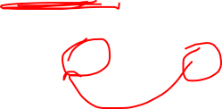
Poll 7.5: Which are Strict Nash Equilibria?
 |  | Student
 |  | Study | Games
Professor | Effort | 1000,1000 | 0,-10
 | Slack | -10,0 | 0,0

Slide 83
Strict Nash Equilibria?
Effort/Study is a Strict NE, Slack/Games is not!
 |  | Student
 |  | Study | Games
Professor | Effort | 1000,1000 | 0,-10
 | Slack | -10,0 | 0,0

Slide 84
Finding a Pure Nash Equilibrium
Pure Nash Equilibria have a pure strategy
Option 1: Examine each state and determine if it fits the criteria
Option 2: Find a dominating strategy and eliminate all other row or columns and recurse
Option 3: Remove a strictly dominated strategy and recurse

Slide 85
Finding a Pure Nash Equilibrium
Option 1: Examine each state and determine if it fits the criteria
Option 2: Find a dominating strategy and eliminate all other row or columns and recurse
Option 3: Remove a strictly dominated strategy and recurse
 | L | C | R
U | 10,3 | 1,5 | 5,4
M | 3,1 | 2,4 | 5,2
D | 0,10 | 1,8 | 7,0

Slide 86
Finding a Pure Nash Equilibrium
Option 1: Examine each state and determine if it fits the criteria
Option 2: Find a dominating strategy and eliminate all other row or columns and recurse
Option 3: Remove a strictly dominated strategy and recurse
 | L | C | R
U | 10,3 | 1,5 | 5,4
M | 3,1 | 2,4 | 5,2
D | 0,10 | 1,8 | 7,0

Slide 87
Finding a Pure Nash Equilibrium
Option 1: Examine each state and determine if it fits the criteria
Option 2: Find a dominating strategy and eliminate all other row or columns and recurse
Option 3: Remove a strictly dominated strategy and recurse
 | L | C | R
U | 10,3 | 1,5 | 5,4
M | 3,1 | 2,4 | 5,2
D | 0,10 | 1,8 | 7,0
 | L | C
U | 10,3 | 1,5
M | 3,1 | 2,4
D | 0,10 | 1,8

Slide 88
Finding a Pure Nash Equilibrium
Option 1: Examine each state and determine if it fits the criteria
Option 2: Find a dominating strategy and eliminate all other row or columns and recurse
Option 3: Remove a strictly dominated strategy and recurse
 | L | C | R
U | 10,3 | 1,5 | 5,4
M | 3,1 | 2,4 | 5,2
D | 0,10 | 1,8 | 7,0
 | L | C
U | 10,3 | 1,5
M | 3,1 | 2,4
D | 0,10 | 1,8

Slide 89
Finding a Pure Nash Equilibrium
Option 1: Examine each state and determine if it fits the criteria
Option 2: Find a dominating strategy and eliminate all other row or columns and recurse
Option 3: Remove a strictly dominated strategy and recurse
 | L | C | R
U | 10,3 | 1,5 | 5,4
M | 3,1 | 2,4 | 5,2
D | 0,10 | 1,8 | 7,0
 | L | C
U | 10,3 | 1,5
M | 3,1 | 2,4
D | 0,10 | 1,8
 | L | C
U | 10,3 | 1,5
M | 3,1 | 2,4

Slide 90
Finding a Pure Nash Equilibrium
Option 1: Examine each state and determine if it fits the criteria
Option 2: Find a dominating strategy and eliminate all other row or columns and recurse
Option 3: Remove a strictly dominated strategy and recurse
 | L | C | R
U | 10,3 | 1,5 | 5,4
M | 3,1 | 2,4 | 5,2
D | 0,10 | 1,8 | 7,0
 | L | C
U | 10,3 | 1,5
M | 3,1 | 2,4
D | 0,10 | 1,8
 | L | C
U | 10,3 | 1,5
M | 3,1 | 2,4

Slide 91
Finding a Pure Nash Equilibrium
Option 1: Examine each state and determine if it fits the criteria
Option 2: Find a dominating strategy and eliminate all other row or columns and recurse
Option 3: Remove a strictly dominated strategy and recurse
 | L | C | R
U | 10,3 | 1,5 | 5,4
M | 3,1 | 2,4 | 5,2
D | 0,10 | 1,8 | 7,0
 | L | C
U | 10,3 | 1,5
M | 3,1 | 2,4
D | 0,10 | 1,8
 | L | C
U | 10,3 | 1,5
M | 3,1 | 2,4
 | C
U | 1,5
M | 2,4

Slide 92
Finding a Pure Nash Equilibrium
Option 1: Examine each state and determine if it fits the criteria
Option 2: Find a dominating strategy and eliminate all other row or columns and recurse
Option 3: Remove a strictly dominated strategy and recurse
 | L | C | R
U | 10,3 | 1,5 | 5,4
M | 3,1 | 2,4 | 5,2
D | 0,10 | 1,8 | 7,0
 | L | C
U | 10,3 | 1,5
M | 3,1 | 2,4
D | 0,10 | 1,8
 | L | C
U | 10,3 | 1,5
M | 3,1 | 2,4
 | C
U | 1,5
M | 2,4

Slide 93
Finding a Pure Nash Equilibrium
Option 1: Examine each state and determine if it fits the criteria
Option 2: Find a dominating strategy and eliminate all other row or columns and recurse
Option 3: Remove a strictly dominated strategy and recurse
 | L | C | R
U | 10,3 | 1,5 | 5,4
M | 3,1 | 2,4 | 5,2
D | 0,10 | 1,8 | 7,0
 | L | C
U | 10,3 | 1,5
M | 3,1 | 2,4
D | 0,10 | 1,8
 | L | C
U | 10,3 | 1,5
M | 3,1 | 2,4
 | C
U | 1,5
M | 2,4
 | C
M | 2,4

Slide 94
Finding Nash Equilibrium Example 1
 | A | B | C | D | E
i | 2,10 | 4,7 | 4,6 | 5,2 | 3,8
ii | 3,8 | 6,4 | 5,2 | 1,3 | 2,6
iii | 5,3 | 3,1 | 2,2 | 4,1 | 3,0
iv | 6,7 | 9,5 | 7,5 | 8,5 | 4,5

Slide 95
Finding Nash Equilibrium Example 1
 | A | B | C | D | E
i | 2,10 | 4,7 | 4,6 | 5,2 | 3,8
ii | 3,8 | 6,4 | 5,2 | 1,3 | 2,6
iii | 5,3 | 3,1 | 2,2 | 4,1 | 3,0
iv | 6,7 | 9,5 | 7,5 | 8,5 | 4,5

Slide 96
Finding Nash Equilibrium Example 2
 | A | B | C | D | E
i | 2,4 | 4,7 | 4,6 | 5,2 | 3,8
ii | 3,8 | 6,4 | 5,2 | 1,3 | 2,6
iii | 5,3 | 3,1 | 2,2 | 9,1 | 3,0
iv | 6,7 | 9,5 | 5,5 | 8,5 | 4,5

Slide 97
Finding Nash Equilibrium Example 2
 | A | B | C | D | E
i | 2,4 | 4,7 | 4,6 | 5,2 | 3,8
ii | 3,8 | 6,4 | 5,2 | 1,3 | 2,6
iii | 5,3 | 3,1 | 2,2 | 9,1 | 3,0
iv | 6,7 | 9,5 | 5,5 | 8,5 | 4,5
No longer strict dominant strategies!

Slide 98
Finding Nash Equilibrium Example 2
 | A | B | C | D | E
i | 2,4 | 4,7 | 4,6 | 5,2 | 3,8
ii | 3,8 | 6,4 | 5,2 | 1,3 | 2,6
iii | 5,3 | 3,1 | 2,2 | 9,1 | 3,0
iv | 6,7 | 9,5 | 5,5 | 8,5 | 4,5

Slide 99
Finding Nash Equilibrium Example 2
 | A | B | C | D | E
i | 2,4 | 4,7 | 4,6 | 5,2 | 3,8
ii | 3,8 | 6,4 | 5,2 | 1,3 | 2,6
iii | 5,3 | 3,1 | 2,2 | 9,1 | 3,0
iv | 6,7 | 9,5 | 5,5 | 8,5 | 4,5
>
D is strictly dominated by A

Slide 100

Finding Nash Equilibrium Example 2
 | A | B | C | D | E
i | 2,4 | 4,7 | 4,6 | 5,2 | 3,8
ii | 3,8 | 6,4 | 5,2 | 1,3 | 2,6
iii | 5,3 | 3,1 | 2,2 | 9,1 | 3,0
iv | 6,7 | 9,5 | 5,5 | 8,5 | 4,5
$$≥$$
D is weakly dominated by B

Slide 101
Finding Nash Equilibrium Example 2
 | A | B | C |  | E
i | 2,4 | 4,7 | 4,6 |  | 3,8
ii | 3,8 | 6,4 | 5,2 |  | 2,6
iii | 5,3 | 3,1 | 2,2 |  | 3,0
iv | 6,7 | 9,5 | 5,5 |  | 4,5

Slide 102
Finding Nash Equilibrium Example 2
 | A | B | C |  | E
i | 2,4 | 4,7 | 4,6 |  | 3,8
ii | 3,8 | 6,4 | 5,2 |  | 2,6
iii | 5,3 | 3,1 | 2,2 |  | 3,0
iv | 6,7 | 9,5 | 5,5 |  | 4,5
<
iii is strictly dominated by iv

Slide 103
Finding Nash Equilibrium Example 2
 | A | B | C |  | E
i | 2,4 | 4,7 | 4,6 |  | 3,8
ii | 3,8 | 6,4 | 5,2 |  | 2,6
iii | 5,3 | 3,1 | 2,2 |  | 3,0
iv | 6,7 | 9,5 | 5,5 |  | 4,5
<
i is strictly dominated by iv

Slide 104
Finding Nash Equilibrium Example 2
 | A | B | C |  | E
ii | 3,8 | 6,4 | 5,2 |  | 2,6
iv | 6,7 | 9,5 | 4,5 |  | 4,5

Slide 105
Finding Nash Equilibrium Example 2
 | A | B | C |  | E
ii | 3,8 | 6,4 | 5,2 |  | 2,6
iv | 6,7 | 9,5 | 4,5 |  | 4,5
>
E is strictly dominated by A

Slide 106
Finding Nash Equilibrium Example 2
 | A | B | C |  | E
ii | 3,8 | 6,4 | 5,2 |  | 2,6
iv | 6,7 | 9,5 | 4,5 |  | 4,5
>
C is strictly dominated by A

Slide 107
Finding Nash Equilibrium Example 2
 | A | B | C |  | E
ii | 3,8 | 6,4 | 5,2 |  | 2,6
iv | 6,7 | 9,5 | 4,5 |  | 4,5
>
B is strictly dominated by A

Slide 108
Finding Nash Equilibrium Example 2
 | A
ii | 3,8
iv | 6,7
ii is strictly dominated by iv

Slide 109
Finding Nash Equilibrium Example 2
 | A
iv | 6,7

Slide 110
Rock, Paper, Scissors – Nash Equlibrium?
 |  | PLAYER 2
 |  | ROCK | PAPER | SCISSORS
PLAYER 1 | ROCK | 0,0 | -1,1 | 1,-1
 | PAPER | 1,-1 | 0,0 | -1,1
 | SCISSORS | -1,1 | 1,-1 | 0,0

Slide 111
Rock, Paper, Scissors – Not with pure strategies!
 |  | PLAYER 2
 |  | ROCK | PAPER | SCISSORS
PLAYER 1 | ROCK | 0,0 | -1,1 | 1,-1
 | PAPER | 1,-1 | 0,0 | -1,1
 | SCISSORS | -1,1 | 1,-1 | 0,0

Slide 112
Nash Equilibria always exist in finite games
Nash 1950
If there are a finite number of players and each player has a finite number of actions, there always exists a Nash Equilibrium
The NE may be pure or it may be a mixed strategy

Slide 113
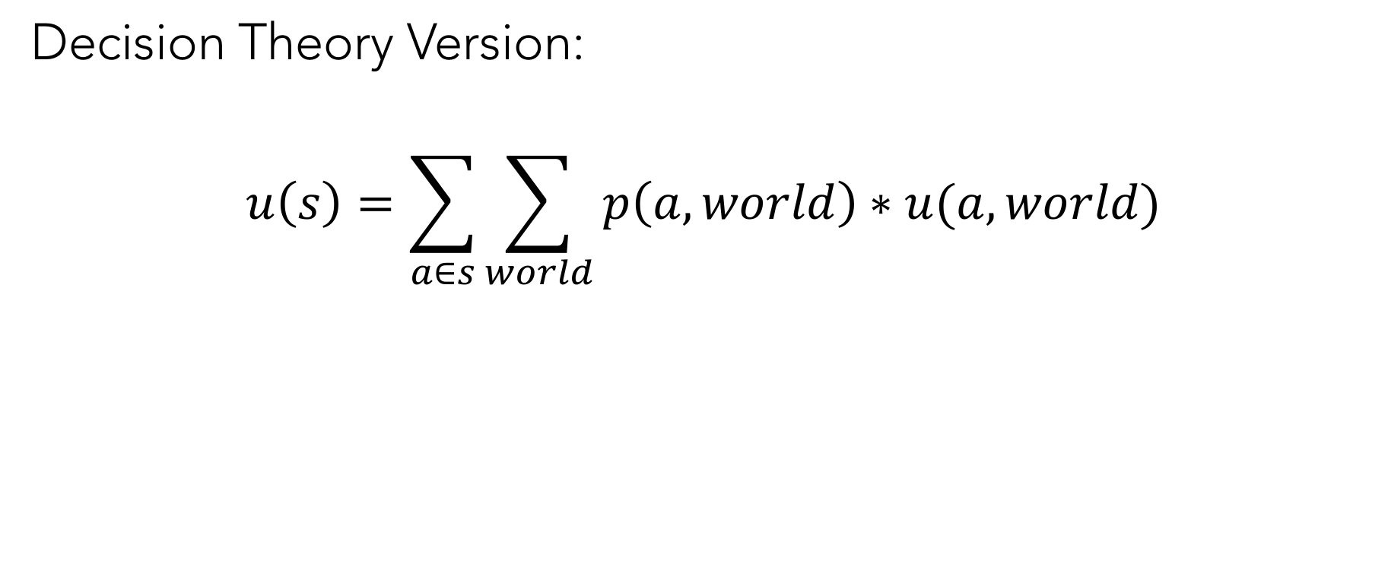
Calculating Utilities of Mixed Strategies
Decision Theory Version:
$$u\left(s\right)=\sum_{a∈s}{\sum_{world}{p\left(a,world\right)∗u(a,world)}}$$

Slide 114
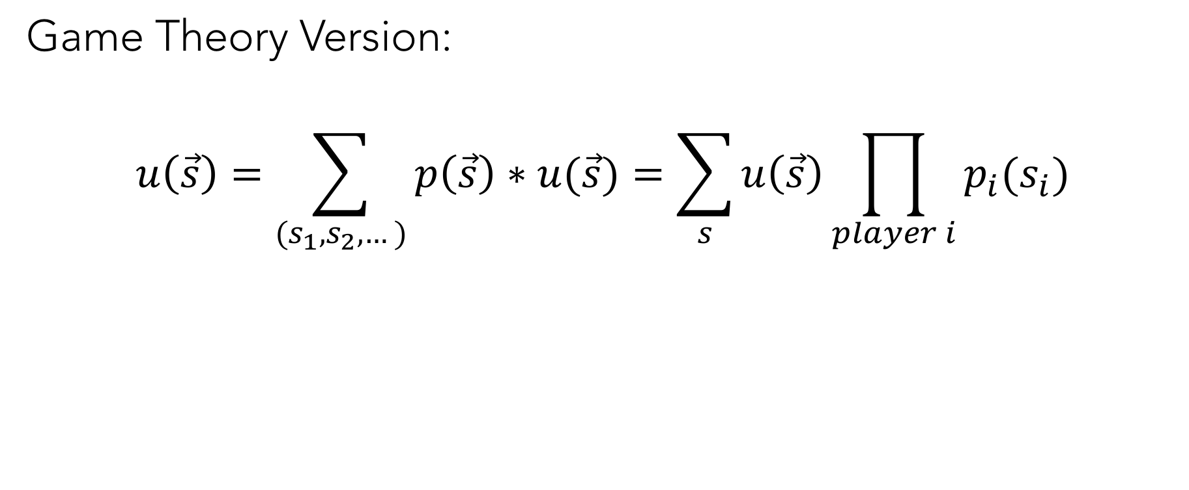
Calculating Utilities of Mixed Strategies
Game Theory Version:
$$u\left(\vec{s}\right)=\sum_{(s_{1},s_{2},…)}{p\left(\vec{s}\right)∗u(\vec{s})}=\sum_{s}{u\left(\vec{s}\right)\prod_{player i}{p_{i}(s_{i})}}$$

Slide 115
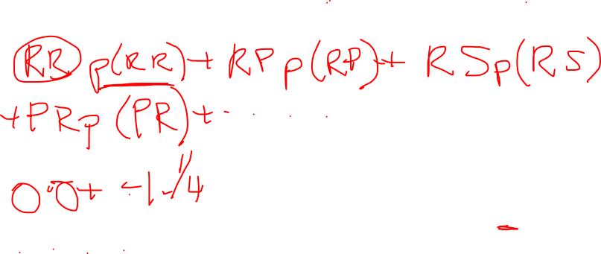
P1 Utility of P1=(½, ½, 0), P2=(0, ½, ½)
 |  | PLAYER 2
 |  | ROCK | PAPER | SCISSORS
PLAYER 1 | ROCK | 0,0 | -1,1 | 1,-1
 | PAPER | 1,-1 | 0,0 | -1,1
 | SCISSORS | -1,1 | 1,-1 | 0,0
Notes:
.5*0*0 + .5*.5*-1 + .5*.5*1 = 0
.5*0*1 + .5*.5*0 + .5*.5*-1 = -.25
0*0*-1 + 0*.5*1 + 0*.5*0 = 0

Slide 116
Poll 8: U1? P1=(1/3, 1/3, 1/3), P2=(1/3, 1/3, 1/3)
 |  | PLAYER 2
 |  | ROCK | PAPER | SCISSORS
PLAYER 1 | ROCK | 0,0 | -1,1 | 1,-1
 | PAPER | 1,-1 | 0,0 | -1,1
 | SCISSORS | -1,1 | 1,-1 | 0,0

Slide 117

Poll 8: U1? P1=(1/3, 1/3, 1/3), P2=(1/3, 1/3, 1/3)
 |  | PLAYER 2
 |  | ROCK | PAPER | SCISSORS
PLAYER 1 | ROCK | 0,0 | -1,1 | 1,-1
 | PAPER | 1,-1 | 0,0 | -1,1
 | SCISSORS | -1,1 | 1,-1 | 0,0
Notes:
0

Slide 118

Is this a mixed strategy equilibrium?
P1=(½, ½, 0), P2=(0, ½, ½)
 |  | PLAYER 2
 |  | ROCK | PAPER | SCISSORS
PLAYER 1 | ROCK U(s) = 0 | 0,0 | -1,1 | 1,-1
 | PAPER U(s) = -.25 | 1,-1 | 0,0 | -1,1
 | SCISSORS U(s) = 0 | -1,1 | 1,-1 | 0,0
Notes:
.5*0*0 + .5*.5*-1 + .5*.5*1 = 0
.5*0*1 + .5*.5*0 + .5*.5*-1 = -.25
0*0*-1 + 0*.5*1 + 0*.5*0 = 0

Slide 119
Is this a mixed strategy equilibrium?
P1=(½, ½, 0), P2=(0, ½, ½)
No! P1 doesn’t want to play paper because their utility is lower
 |  | PLAYER 2
 |  | ROCK | PAPER | SCISSORS
PLAYER 1 | ROCK U(s) = 0 | 0,0 | -1,1 | 1,-1
 | PAPER U(s) = -.25 | 1,-1 | 0,0 | -1,1
 | SCISSORS U(s) = 0 | -1,1 | 1,-1 | 0,0
Notes:
.5*0*0 + .5*.5*-1 + .5*.5*1 = 0
.5*0*1 + .5*.5*0 + .5*.5*-1 = -.25
0*0*-1 + 0*.5*1 + 0*.5*0 = 0

Slide 120
Finding the Mixed Strategy Nash Equilibrium
What features of a mixed strategy qualify it as a NE?
There is no reason for either player to deviate from their strategy, which occurs when the utilities of the weighted actions are equal!

Slide 121
Finding the Mixed Strategy Nash Equilibrium
What features of a mixed strategy qualify it as a NE?
There is no reason for either player to deviate from their strategy, which occurs when the utilities of the weighted actions are equal!

Slide 122
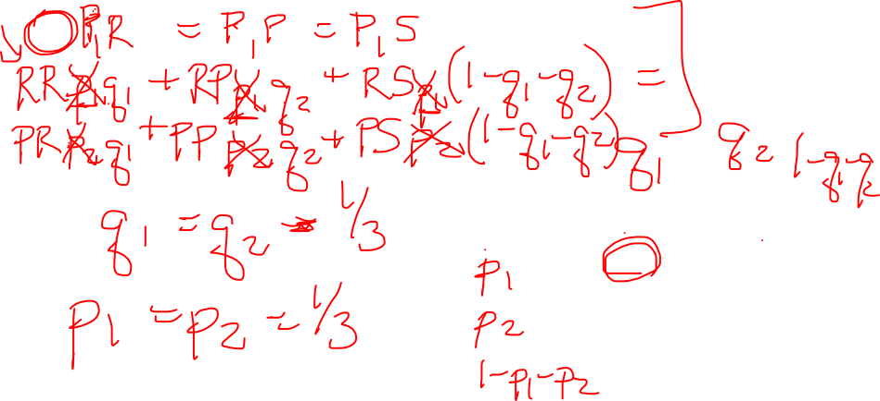
Finding the Mixed Strategy Nash Equilibrium
P1
 |  | PLAYER 2
 |  | ROCK | PAPER | SCISSORS
PLAYER 1 | ROCK | 0,0 | -1,1 | 1,-1
 | PAPER | 1,-1 | 0,0 | -1,1
 | SCISSORS | -1,1 | 1,-1 | 0,0
P2

Slide 123
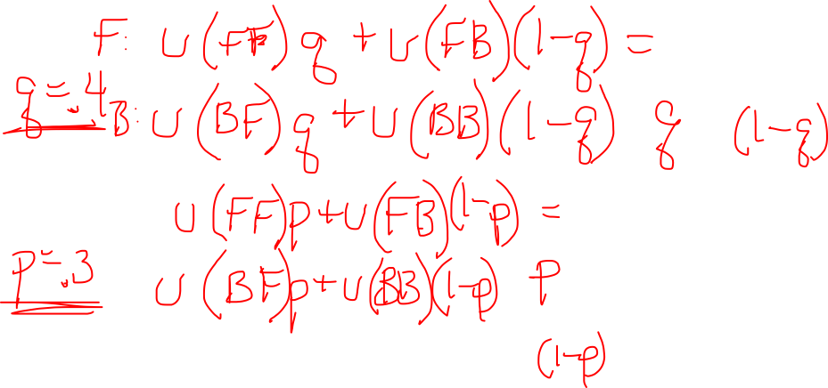
Another Mixed Strategy NE
P1
TENNIS |  | Receiver
 |  | F | B
Server | F | 90,10 | 20,80
 | B | 30,70 | 60,40
P2
Notes:
90q+20(1-q) = 30q+60(1-q)
70q + 20 = -30q+60
100q = 40
q = .4 -> Receiver’s mixed strategy
10p+70(1-p) = 80p+40(1-p)
-60p+70 = 40p+40
30 = 100p
p = .3 -> Server’s mixed strategy

Slide 124
Other Properties of Strategies
Correlated Equilibrium
Pareto Optimal/Dominated

Slide 125
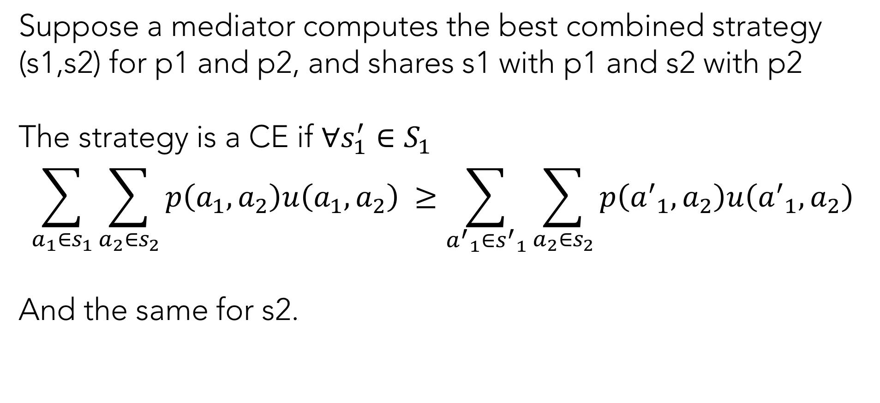
Correlated Equilibrium
Suppose a mediator computes the best combined strategy (s1,s2) for p1 and p2, and shares s1 with p1 and s2 with p2
The strategy is a CE if $∀s_{1}^{′}∈S_{1}$
$${\sum_{a_{1}∈s_{1}}{\sum_{{a_{2}∈s}_{2}}{p\left(a_{1},a_{2}\right)u\left(a_{1},a_{2}\right)}}}_{ }≥{\sum_{{a^{′}}_{1}∈{s^{′}}_{1}}{\sum_{{a_{2}∈s}_{2}}{p\left({a^{′}}_{1},a_{2}\right)u\left({a^{′}}_{1},a_{2}\right)}}}_{ }$$
And the same for s2.

Slide 126
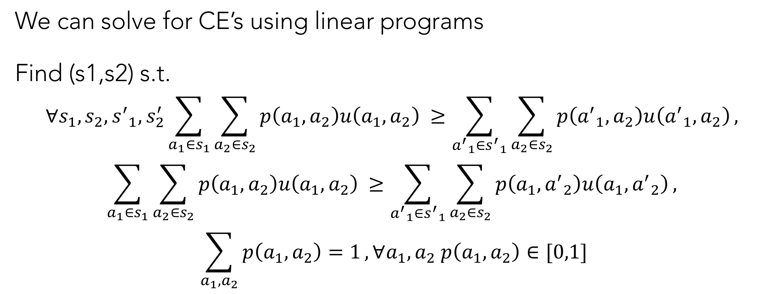
Solving for Correlated Equilibrium
We can solve for CE’s using linear programs
Find (s1,s2) s.t.
$$∀s_{1},s_{2},{s^{′}}_{1},s_{2}^{′}{\sum_{a_{1}∈s_{1}}{\sum_{{a_{2}∈s}_{2}}{p\left(a_{1},a_{2}\right)u\left(a_{1},a_{2}\right)}}}_{ }≥{\sum_{{a^{′}}_{1}∈{s^{′}}_{1}}{\sum_{{a_{2}∈s}_{2}}{p\left({a^{′}}_{1},a_{2}\right)u\left({a^{′}}_{1},a_{2}\right)},}}_{ }$$
$${\sum_{a_{1}∈s_{1}}{\sum_{{a_{2}∈s}_{2}}{p\left(a_{1},a_{2}\right)u\left(a_{1},a_{2}\right)}}}_{ }≥{\sum_{{a^{′}}_{1}∈{s^{′}}_{1}}{\sum_{{a_{2}∈s}_{2}}{p\left(a_{1},{a^{′}}_{2}\right)u\left(a_{1},{a^{′}}_{2}\right)},}}_{ }$$
$$\sum_{a_{1},a_{2}}{p\left(a_{1},a_{2}\right)=1}, ∀a_{1},a_{2} p\left(a_{1},a_{2}\right)∈[0,1]$$

Slide 127
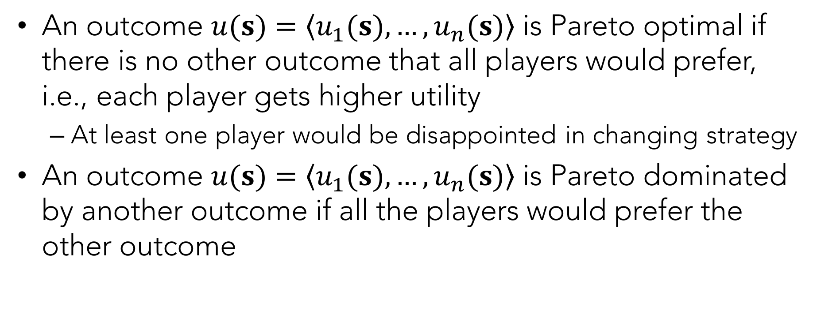
Pareto Optimal and Pareto Dominated
An outcome $u(s)=〈u_{1}(s),…,u_{n}(s)〉$ is Pareto optimal if there is no other outcome that all players would prefer, i.e., each player gets higher utility
At least one player would be disappointed in changing strategy
An outcome $u(s)=〈u_{1}(s),…,u_{n}(s)〉$ is Pareto dominated by another outcome if all the players would prefer the other outcome

Slide 128

Summary
Vocabulary
Pure/Mixed Strategies (and calculating them)
Zero-Sum Games
Dominant vs Dominated Strategies
Strict/Weak Nash Equilibrium
Tragedy of the Commons
Correlated Equilibrium
Pareto Optimal/Dominated
Social Welfare

